Slide 1
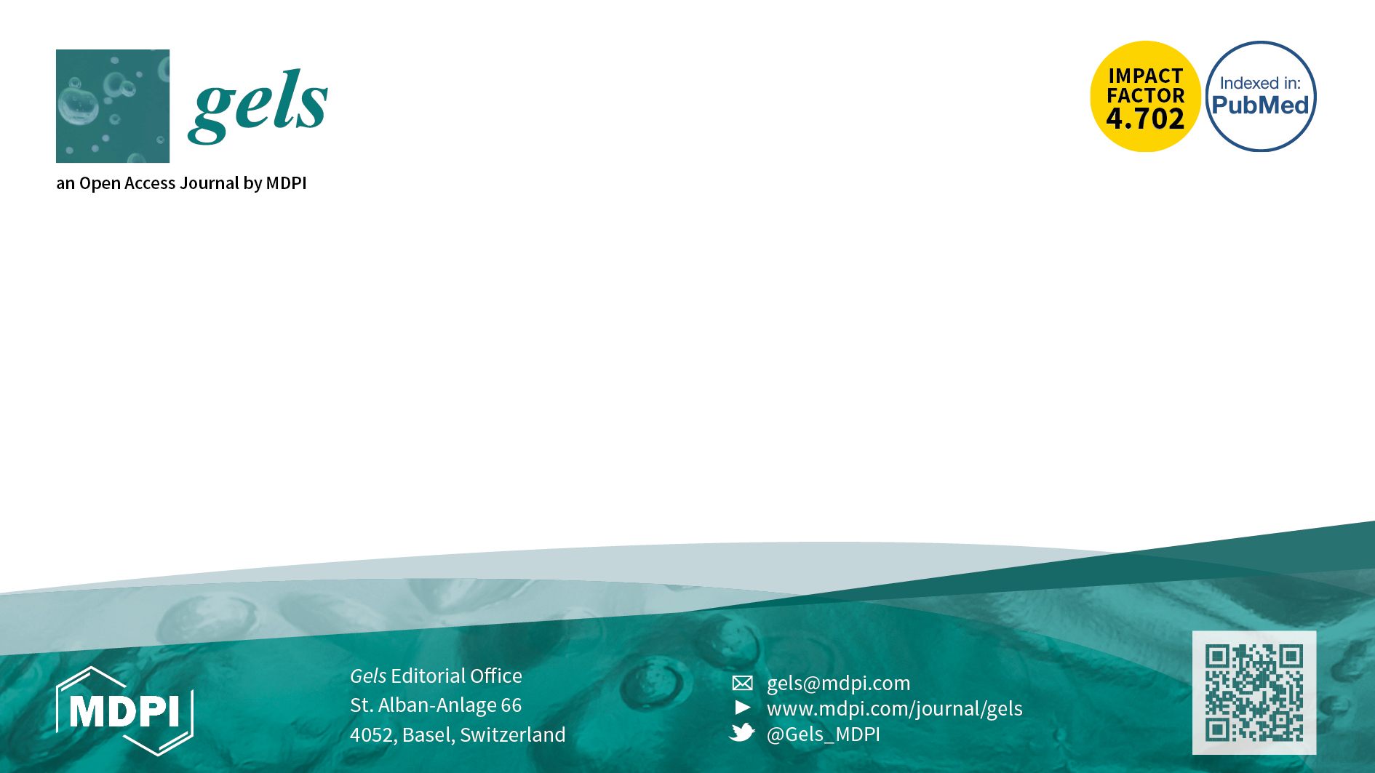
Welcome all submissions on
gel-related research!
Aims and Scope
SCIE (IF 2021： 4.702) High Visibility | PubMed High Visibility
14.7days Submission to First Decision (median values for papers published in this journal in the first half of 2021) | 3.9days Acceptance to publication (median values for papers published in this journal in the 1st half of 2021)
Gels (ISSN 2310-2861) is an international peer-reviewed open access on physical and chemical gels, and is published quarterly online by MDPI.
Organogels, hydrogels and ionic
Dried-gels;
Colloidal gels;
Gels made in mixtures of solvents;
Computational modeling of these materials in order to provide a better understanding of gelation mechanism;
Synthesis, characterization and applications of the above-mentioned materials
Gels as raw materials for the synthesis of non-gel functional materials

